Slide 1
Franchising

Slide 2
Prominent form in the US
mid-1800’s : Albert Singer used franchising as a means of distributing his sewing machines throughout the United States.
in the mid-1900’s : retail and fast food chains.
Modern franchising : franchising law in the 1970s
In the US : 3% of GDP; 50% of retail sales; 38% of units of 20O largest franchises are outside US borders

Slide 3
Definition
The franchiser grants the franchisee the right to offer, supply or distribute goods or services under a system substantially controlled by the franchiser.
The franchisee may use the franchiser’s brand name, logo, products or mode of operation in exchange for royalty payment.
US franchising law under Federal Trade Commission Rule (FTC) : right to use franchiser’s trademark/required payment/significant assistance and control.
Different types :
  Mobile franchising
  Co-ownership franchise
  Leasing franchising

Slide 4
Pros and Cons for franchiser
advantages
  Quick and relatively cheap mode of expansion
  Financial : a rent or share in profits
  Service fees
  A motivated manager
  Knowledge of local consumers
Disadvantages
  When managers do not respect the trademark

Slide 5
Pros and cons for franchisee
advantages
  Greater chance of success than an independent business
  Being their own boss
  Selling a well-established product
  Training and support
  Benefits of marketing and forecasting
disadvantages
  Average franchise start-up cost is $200,000
  Royalty: 1% to 12% of sales
  Strict adherence to standardized operations
  Limited product range

Slide 6
Marketing strategies conducive to franchising
Multi-domestic strategy (strong adaptation): ex Coca Cola. (Coca Cola Energy US and UK; Mezzo Mix in Germany (2007). Multi-brand company. Ex : Fanta.
Transnational strategy (some adaptation): McDonalds.

Slide 7
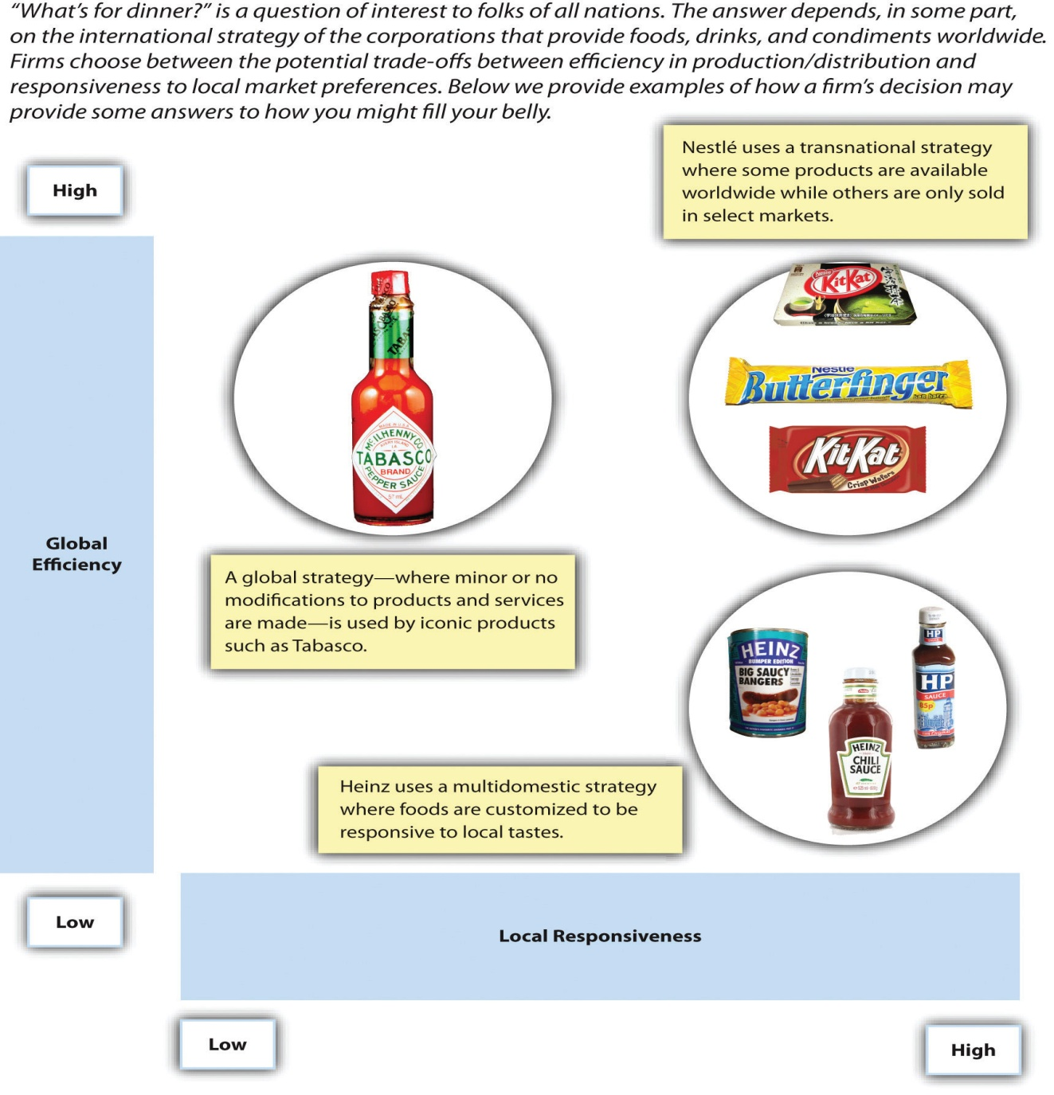
Notes:
https://open.lib.umn.edu/app/uploads/sites/11/2015/04/f2c450c96daad576ad108e3afed0a5cc.jpg

Slide 8
Entry Modes
Exporting
Licensing
Franchising
Joint venture
FDI

Slide 9
Franchising laws worldwide
China’s first franchising law in 1997 was clarified and strengthened in 2005.
India : no specific legislation, but a number of laws that affect the franchisor-franchisee relationship
Brazil : December 2019 new franchising law encourages investment
2020: Saudi Arabia updated franchising laws and introduced legislation to make foreign investment easier in 2023 (equality foreign/Saudi investors)
UAE franchising law: franchises registered with the Ministry must have a UAE national individual or group as a franchisee. But registration is not compulsory for franchises.

Slide 10
Globalisation and franchising
Growing global consumer market
Rising franchising market in emerging markets
Cultural congruence : ex China and KFC (chicken)
Product and experience : a western experience
Some large franchising consortiums:
  Americana in the MENA region (KFC, Pizza Hut, Hardee’s, Krispy Kreme and TGI Fridays, Wimpy and Chicken Tikka)
  Al Futtaim group (Zara, Marks & Spencer) in UAE and Majib Al Futtaim (Carrefour franchise)

Slide 11
The example of Mc Donalds: challenges of franchising in China
Difficulties in franchising 2013-2017:
33% Mc Donald’s restaurants were franchises/66% owned by McDonalds.
From 2013 : sales fell.
issues : size and diversity in the country but a standardized business model (or they risk facing expensive legal penalties)
cultural differences between Chinese regions make compliance with a single business model difficult/franchisor’s control is a challenge.
A new franchising consortium from 2017:
gave franchising control of 75% McDonald’s restaurants in China to the Citic/Carlyle consortium for a period of 20 years.
aim: increase number of restaurants to around 4,000 by 2022. Reach 2-tier cities (less competition).

